Slide 1
Scientific Software Engineer Exercise
Joshua Minien

Slide 2
Solution outline
Data Science project structure
Data files
Forecaster’s reference book programme built in Python3
Further ideas

Slide 3
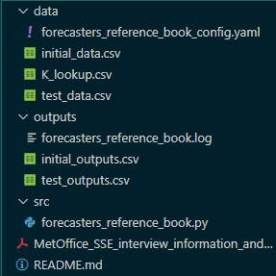
Data science project structure

Slide 4
Data files
Configuration
K value lookup data sheet
Data to be processed for forecasting

Slide 5
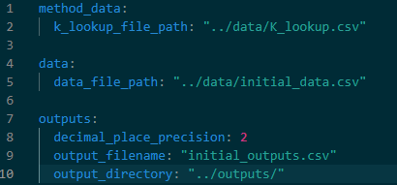
Configuration

Slide 6
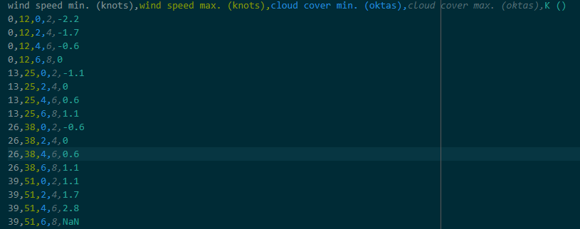
K value lookup data sheet

Slide 7

Data to be processed for forecasting

Slide 8
Forecaster’s reference book programme
For simplicity I have only added INFO level logging
Imported modules: numpy, pandas, yaml
YAML file imports for configuration
K value imported from .csv file as a pandas DataFrame with correct data types
Process data imported from .csv file as a pandas DataFrame with correct data types
Uses numpy arrays to efficiently find the relevant K values for data
Lambda function on imported data DataFrame to evaluate the minimum temperature at 12 pm
Write appended DataFrame to an output .csv file

Slide 9
Code demo

Slide 10
Forecaster’s reference book programme- Test output
Date | Location | Midday Temperature (℃) | Midday Dew Point (℃) | Wind (Kn) | Cloud (oktas) | Forecasted Minimum Temperature (℃)
1 | A | 22.4 | 10.9 | 14.56 | 3.9 | 11.81
1 | B | 18.6 | 12.65 | 3.4 | 6 | 10.97
2 | B | 26 | 8.5 | 0 | 0.0 | 9.43
2 | C | 13.2 | 9.4 | 12.5 | 4.1 | 6.38

Slide 11
Further ideas
Add unit tests for programme such that it could be used in a CI/CD pipeline
If in a large code base:
Write function for the computation that uses numpy arrays
Write function to a module
Import module where relevant in the code base
Implement more robust logging and error handling for team coding and use a VCS
Code uses vectorisation ready for larger data inputs
We do not have raw data to compare; if available import these data to conduct a statistical test for testing accuracy of historical method
Development team for the work, assuming automations are in place:
Scientist requesting code
Developer
Code reviewer

